Slide 1
Amazon Shipping Analytics
File created on: 9/14/2021 4:17:08 PM

Slide 2
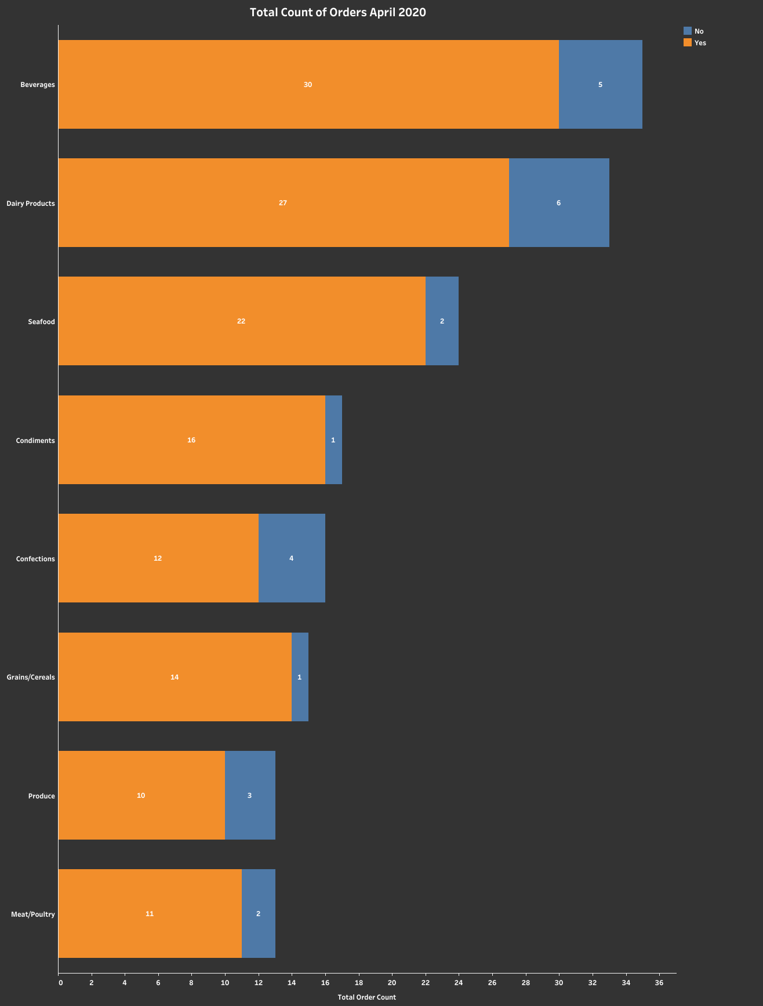

Slide 3
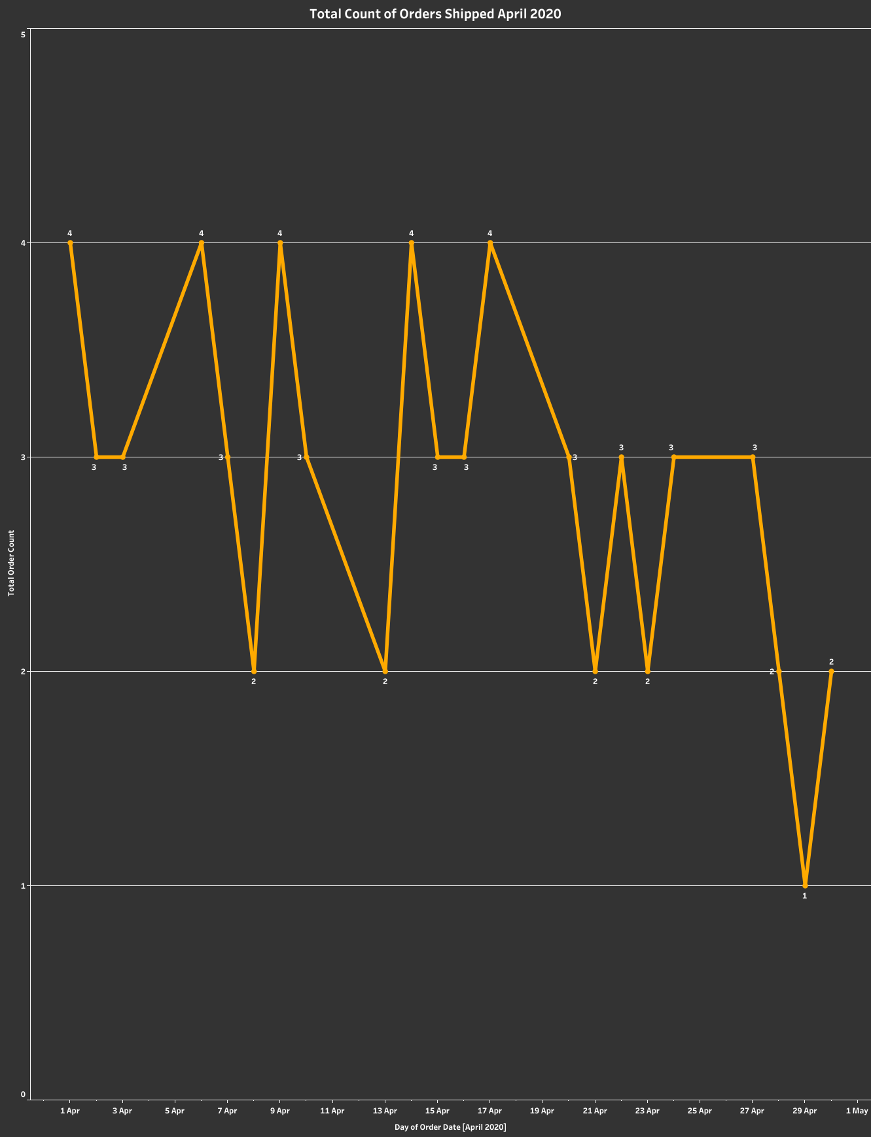

Slide 4
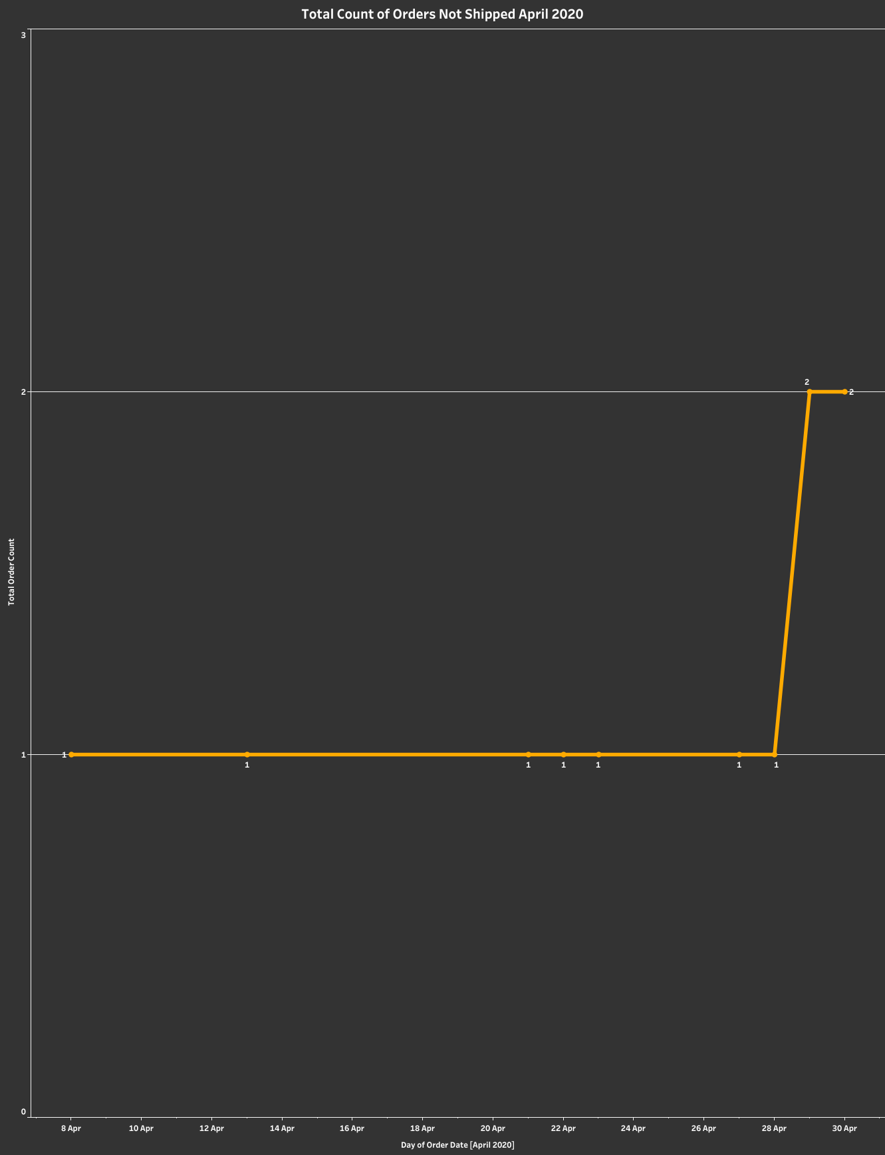

Slide 5
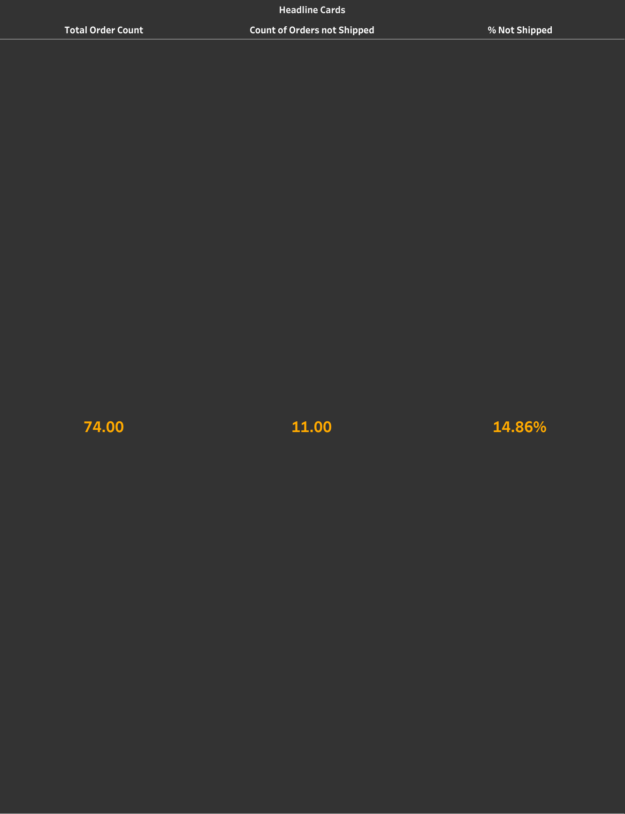

Slide 6
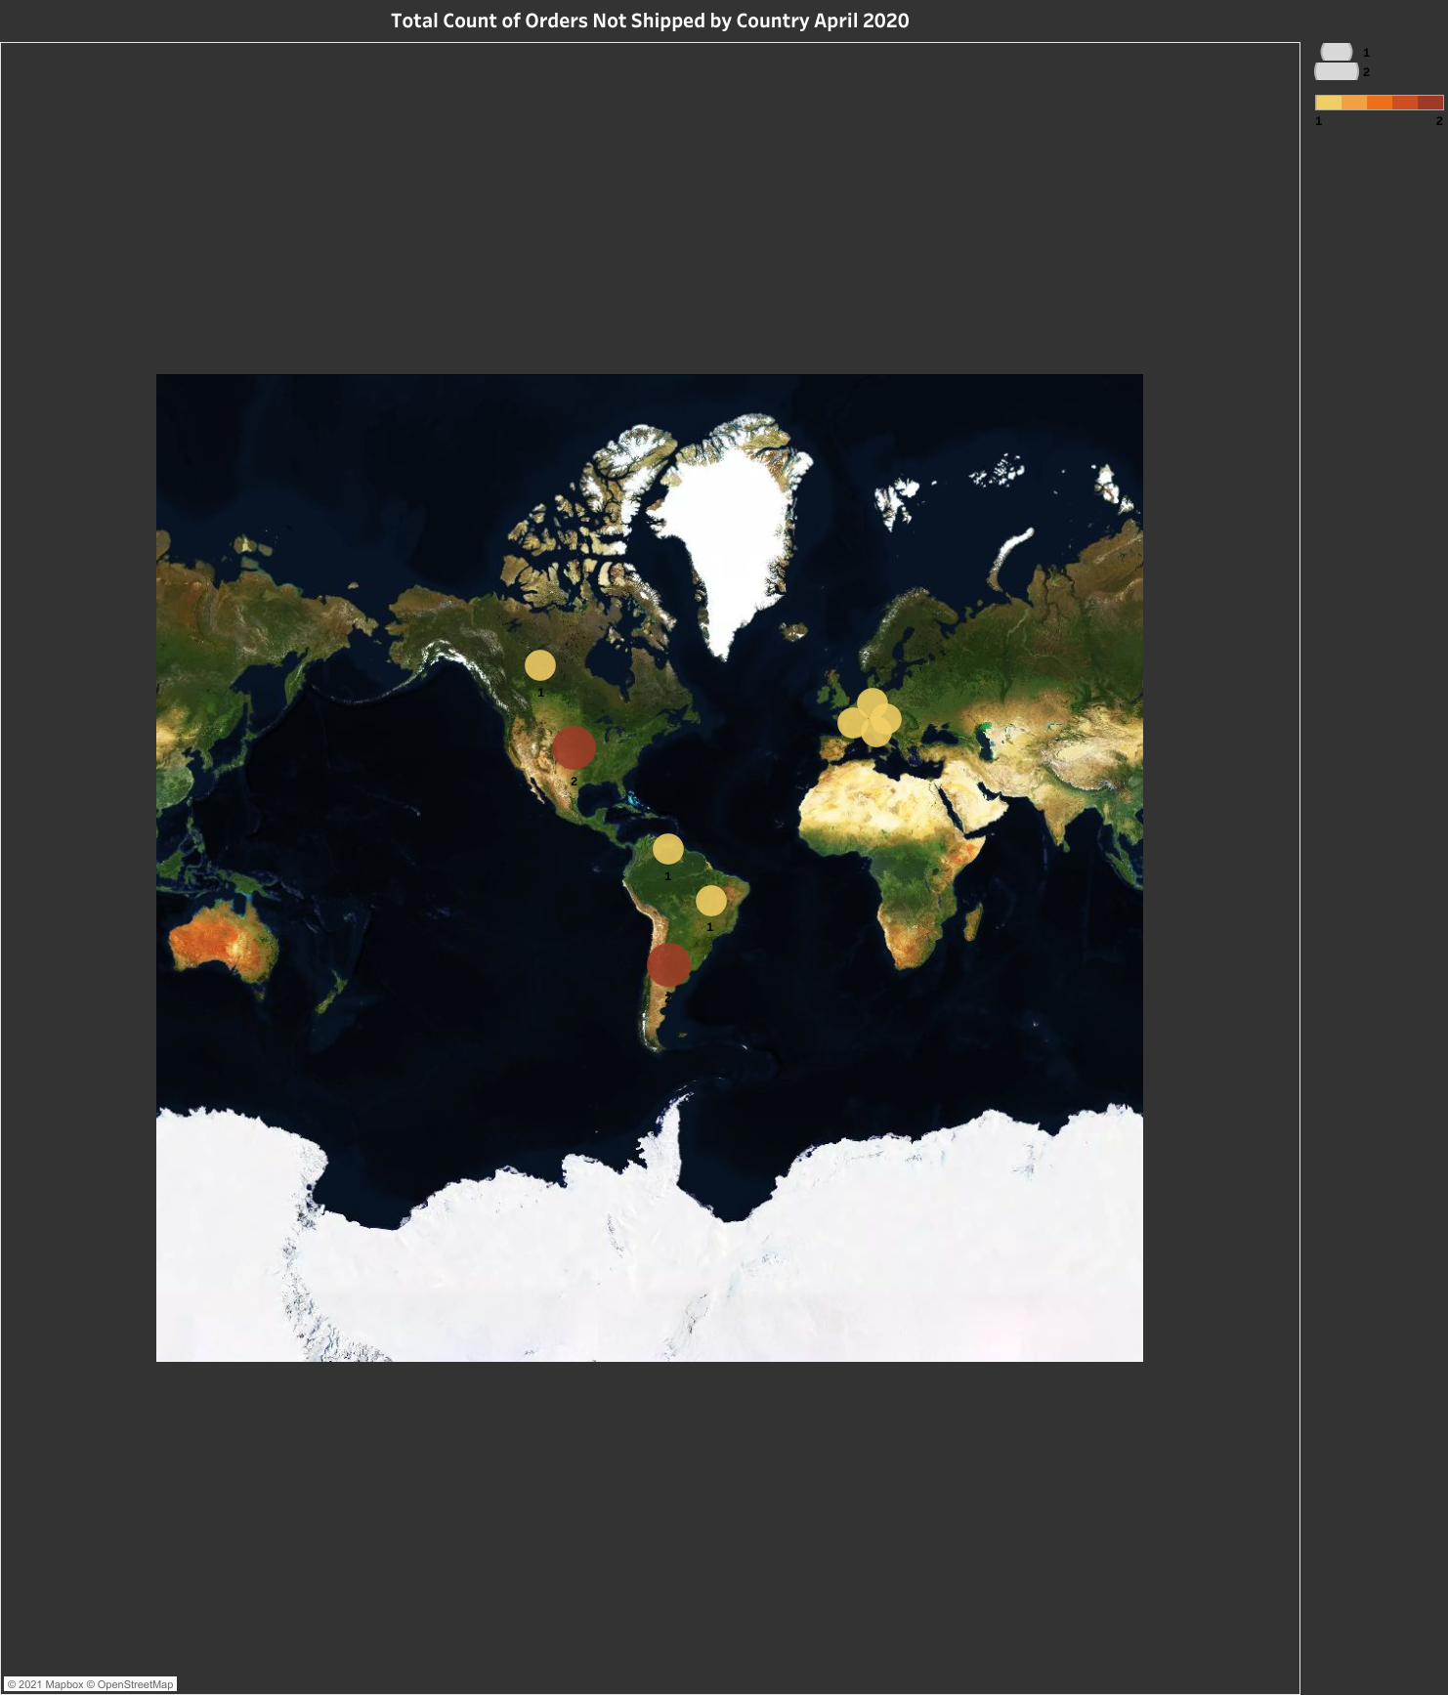

Slide 7
